Slide 1
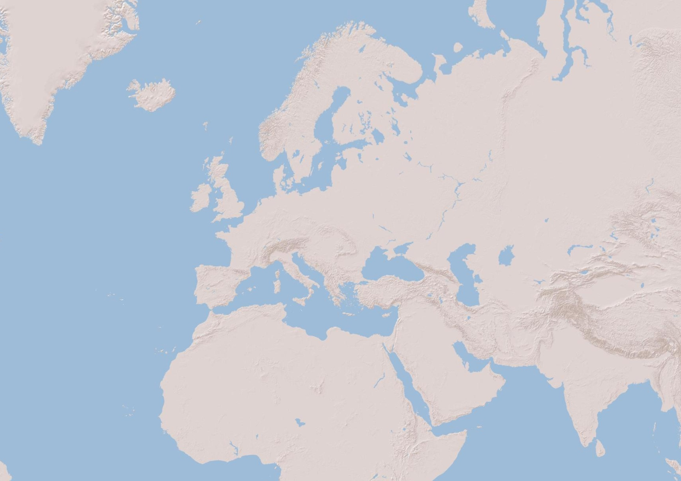
DIGITAL ELEVATION MODEL (Sources: Esri, DeLorme, USGS, NPS)

Slide 2
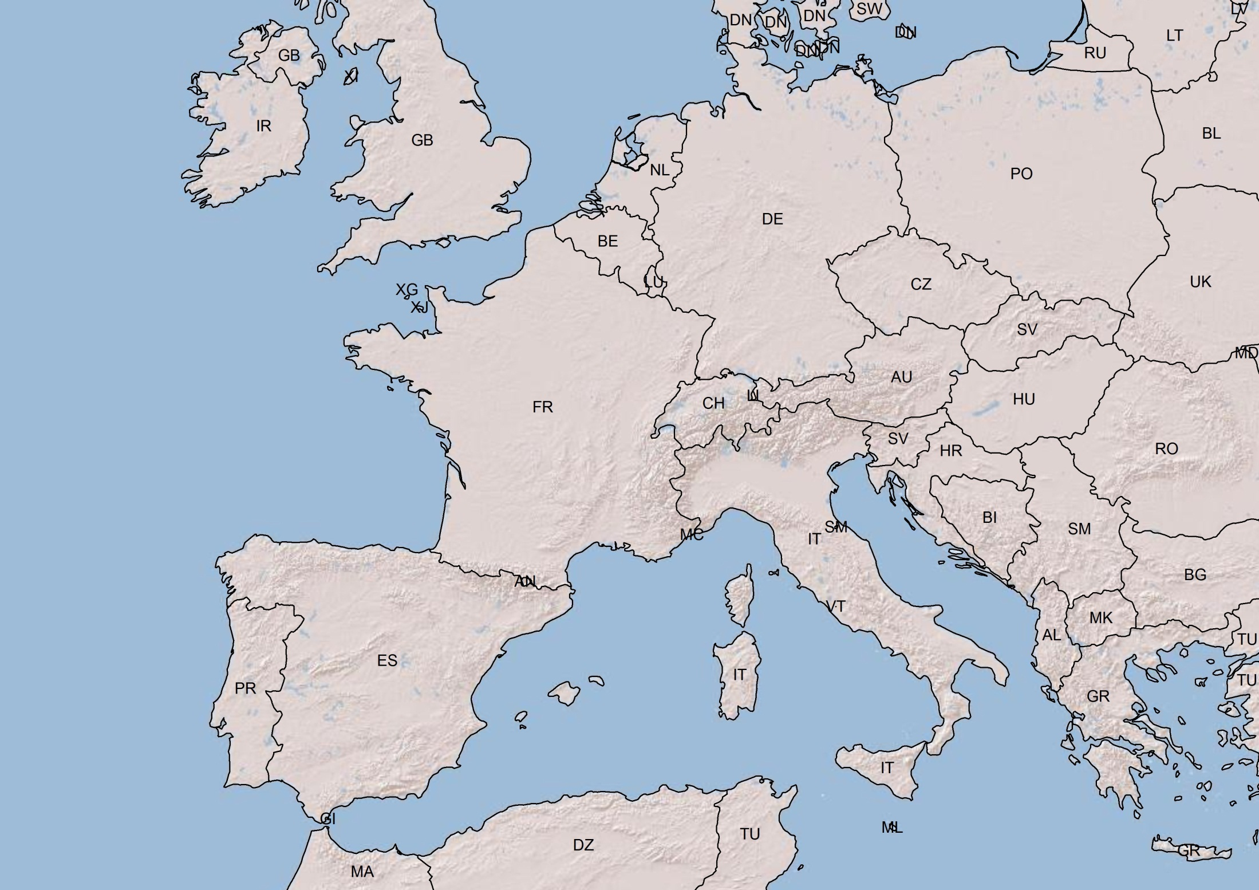
DIGITAL ELEVATION MODEL (Sources: Esri, DeLorme, USGS, NPS)

Slide 3
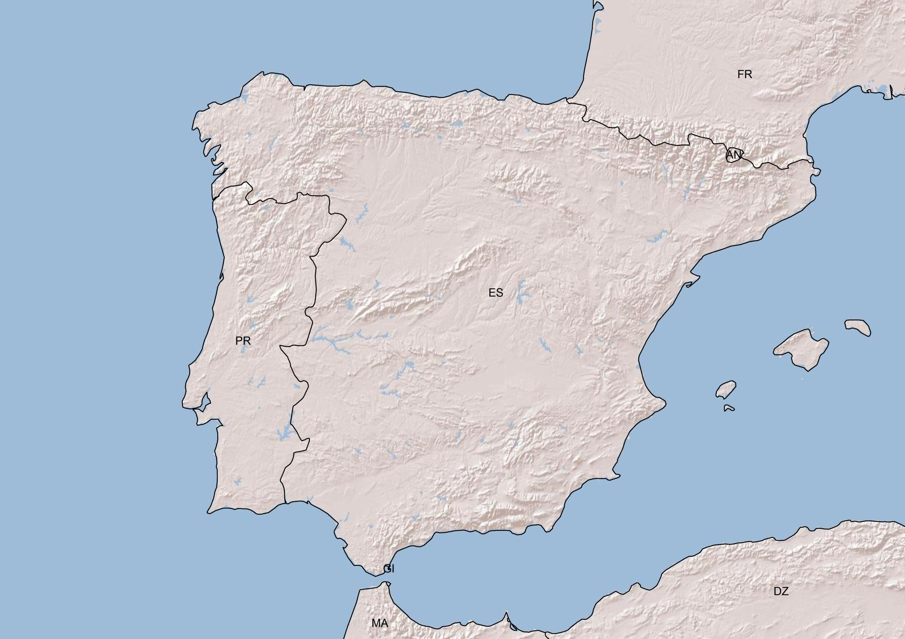
CANTABRIAN MOUNTAINS
GALICIAN MASSIF
PYRENEES
CENTRAL PLATEAU (N)
IBIERIAN SYSTEM
CENTRAL SYSTEM
CENTRAL PLATEAU (S)
SIERRA MORENA
BAETIC SYSTEM
DIGITAL ELEVATION MODEL (Sources: Esri, DeLorme, USGS, NPS)

