Slide 1
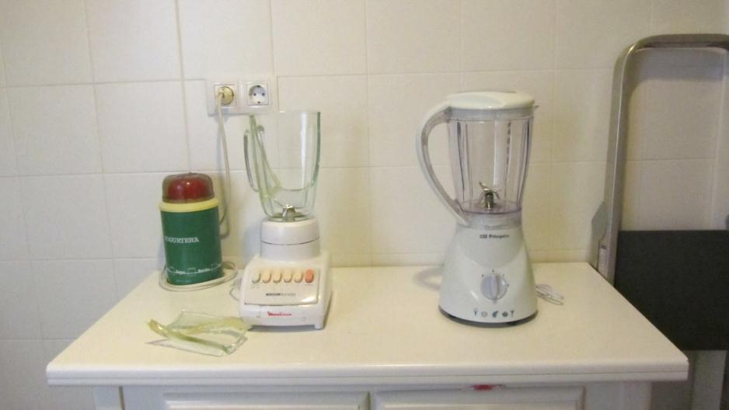
C
A
B
Blender (60 euros, 2000). Glass broken (35 euros).
New blender (32 euros, 2013). What can I do with the old one?
Yoghurt-maker (1960). Still running!

Slide 2
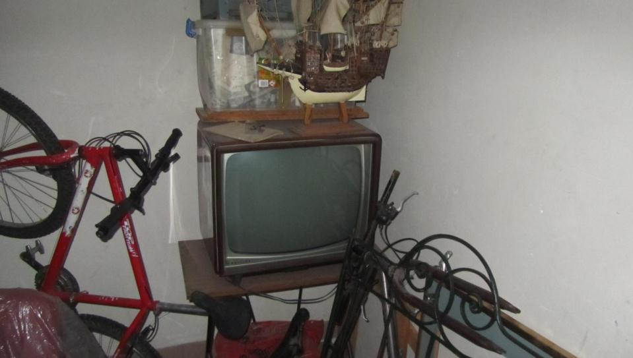
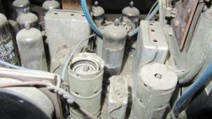
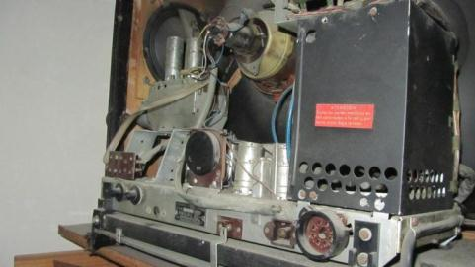
Television set. ‘70s. Black and white. Price: Three times medium salary

Slide 3
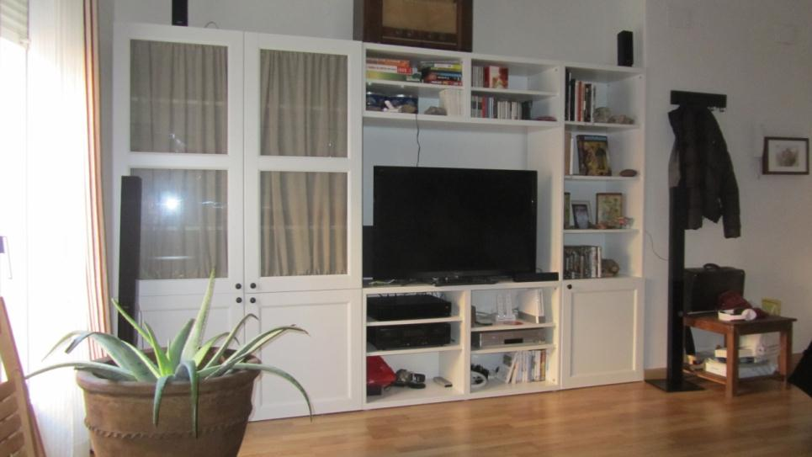
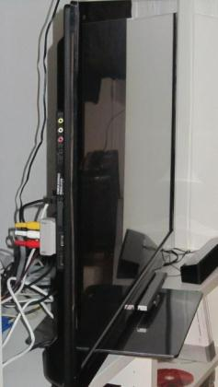
E
Television set. Flat. LED. Price: A third of basic salary

Slide 4
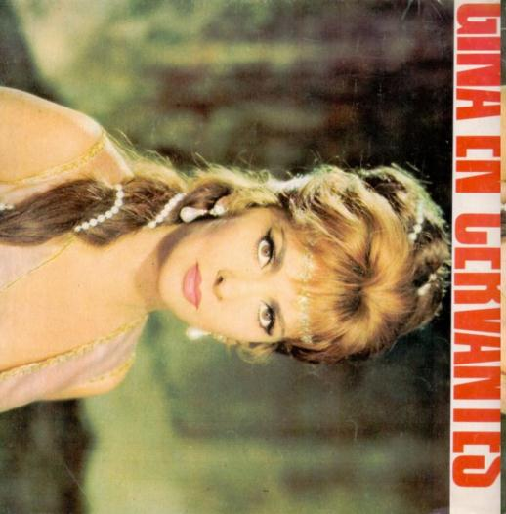

Slide 5
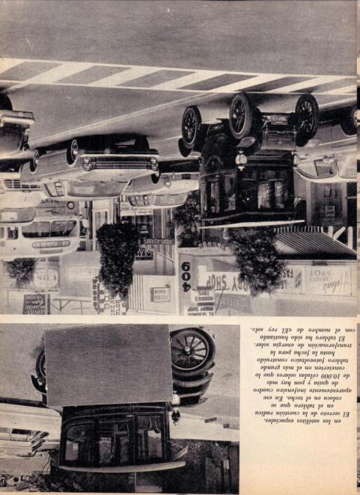
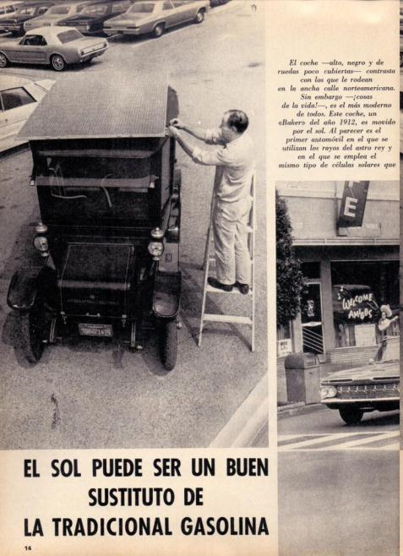

Slide 6
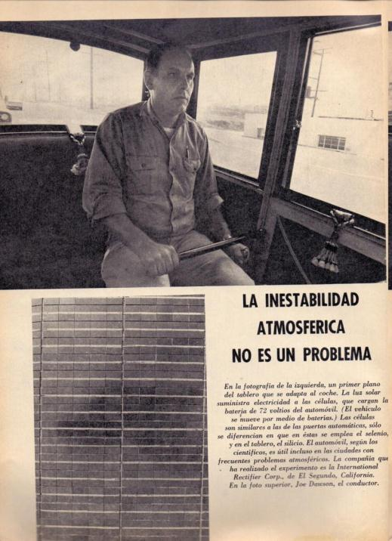
International Rectifier Corp. (El Segundo , California)

Slide 7
http://www.automostory.com/first-solar-car.htm
http://www.internationalrectifier.com/
http://www.alibaba.com/showroom/solar-electric-car.html

Slide 8
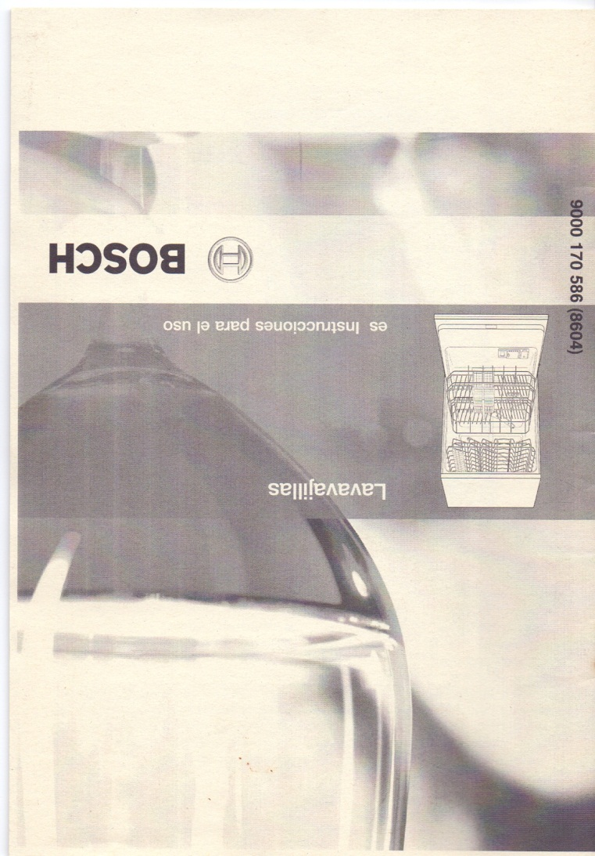
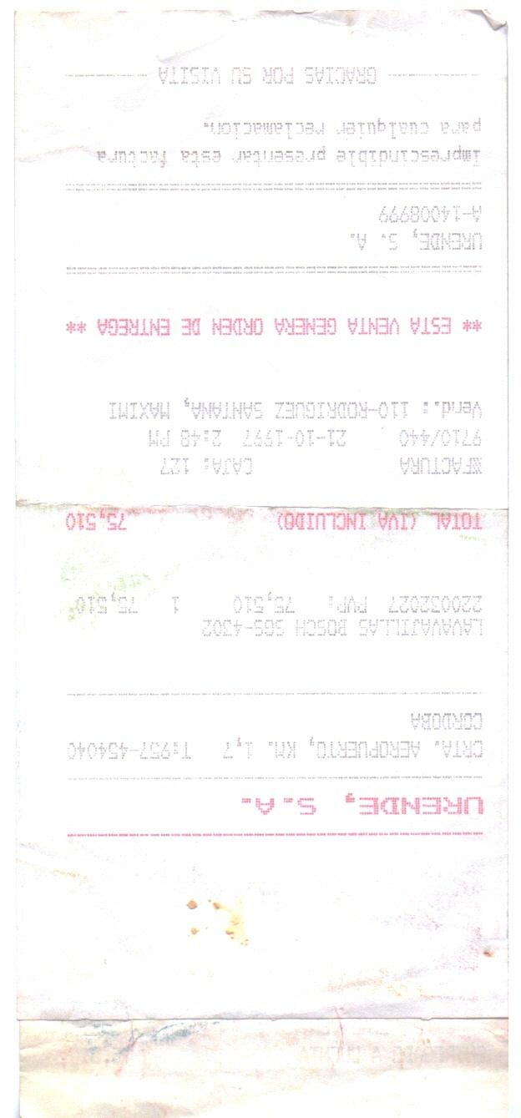
453,82 EUROS

Slide 9
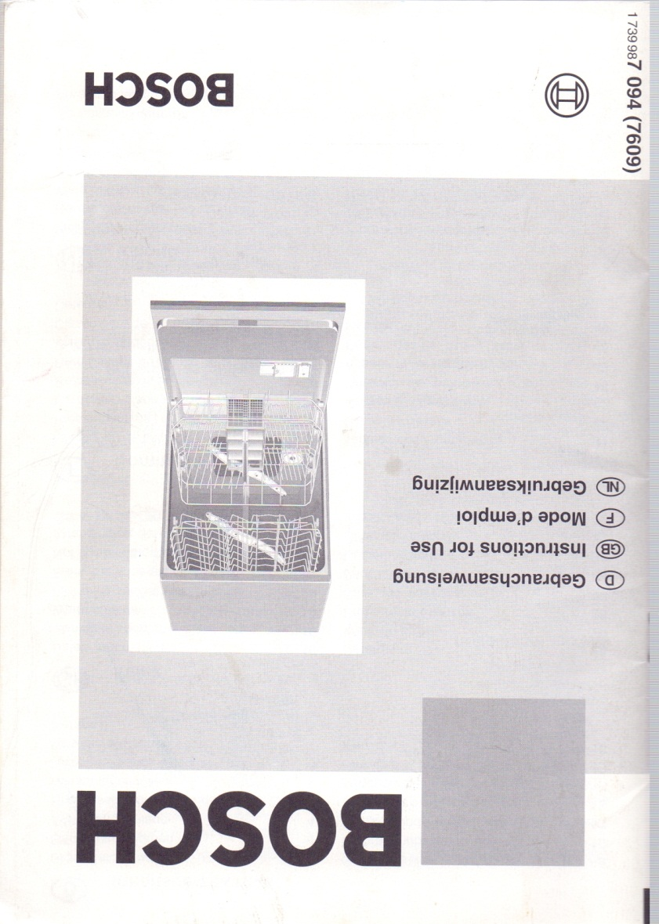
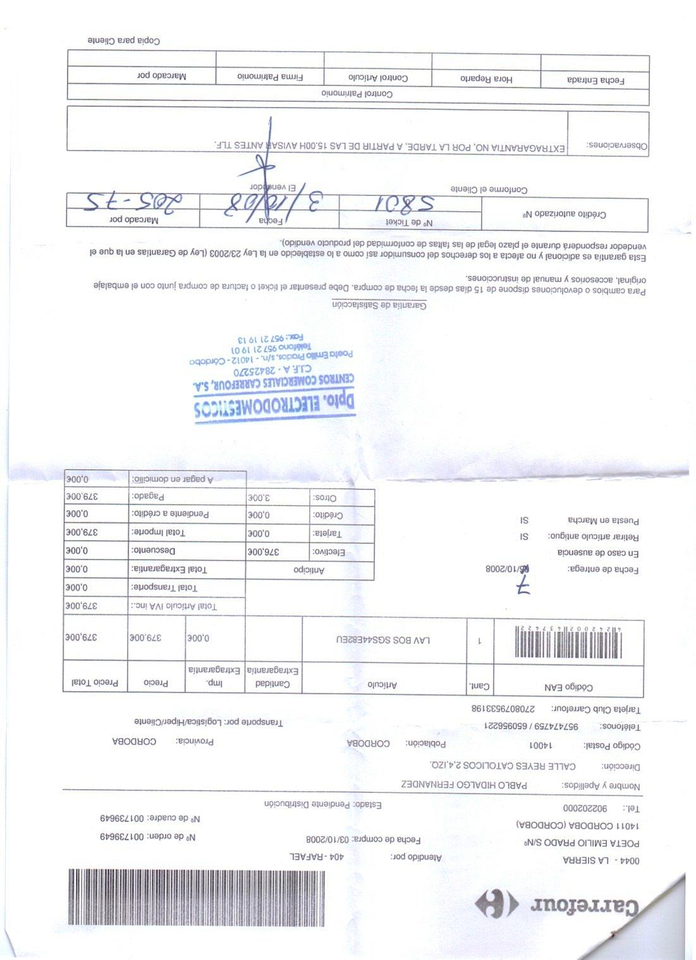
379,00 EUROS

