Slide 1
PHOTHSYSTHESIS
EFFECT OF GLOBAL WARMING AND INCREASE OF CO₂

Slide 2
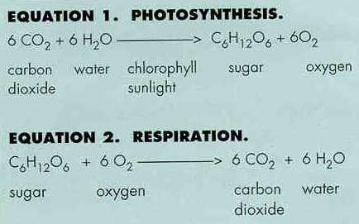
The reaction

Slide 3
Photosynthesis - Respiration-Combustion
Photosynthesis CO₂ + H₂O + sunlight -> CH₂O + O₂
Respiration O₂ + CH₂O -> energy + H₂O + CO₂
Combustion O₂ + hydrocarbons -> energy + H₂O + CO₂

Slide 4
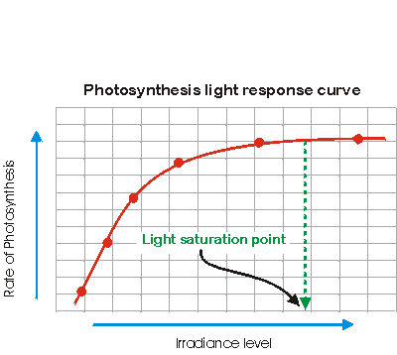

Slide 5
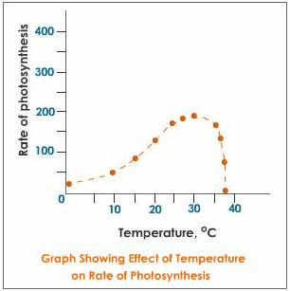
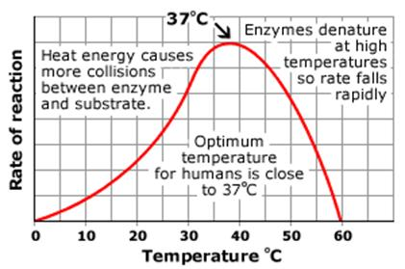

Slide 6
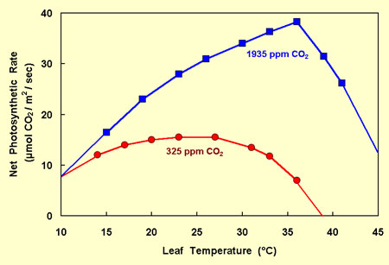

Slide 7
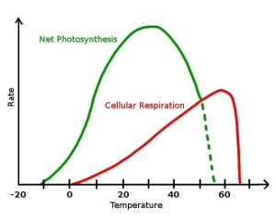
photosYNTHESIS VS. RESPIRATION

Slide 8
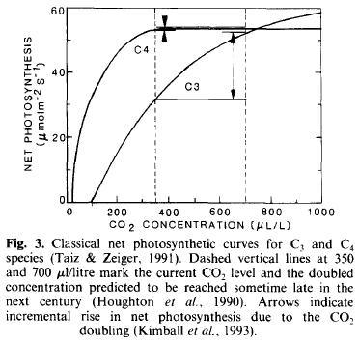
C3 AND C4 RESPONSES
http://www.ehleringer.net/Jim/Publications/271.pdf

