Slide 1
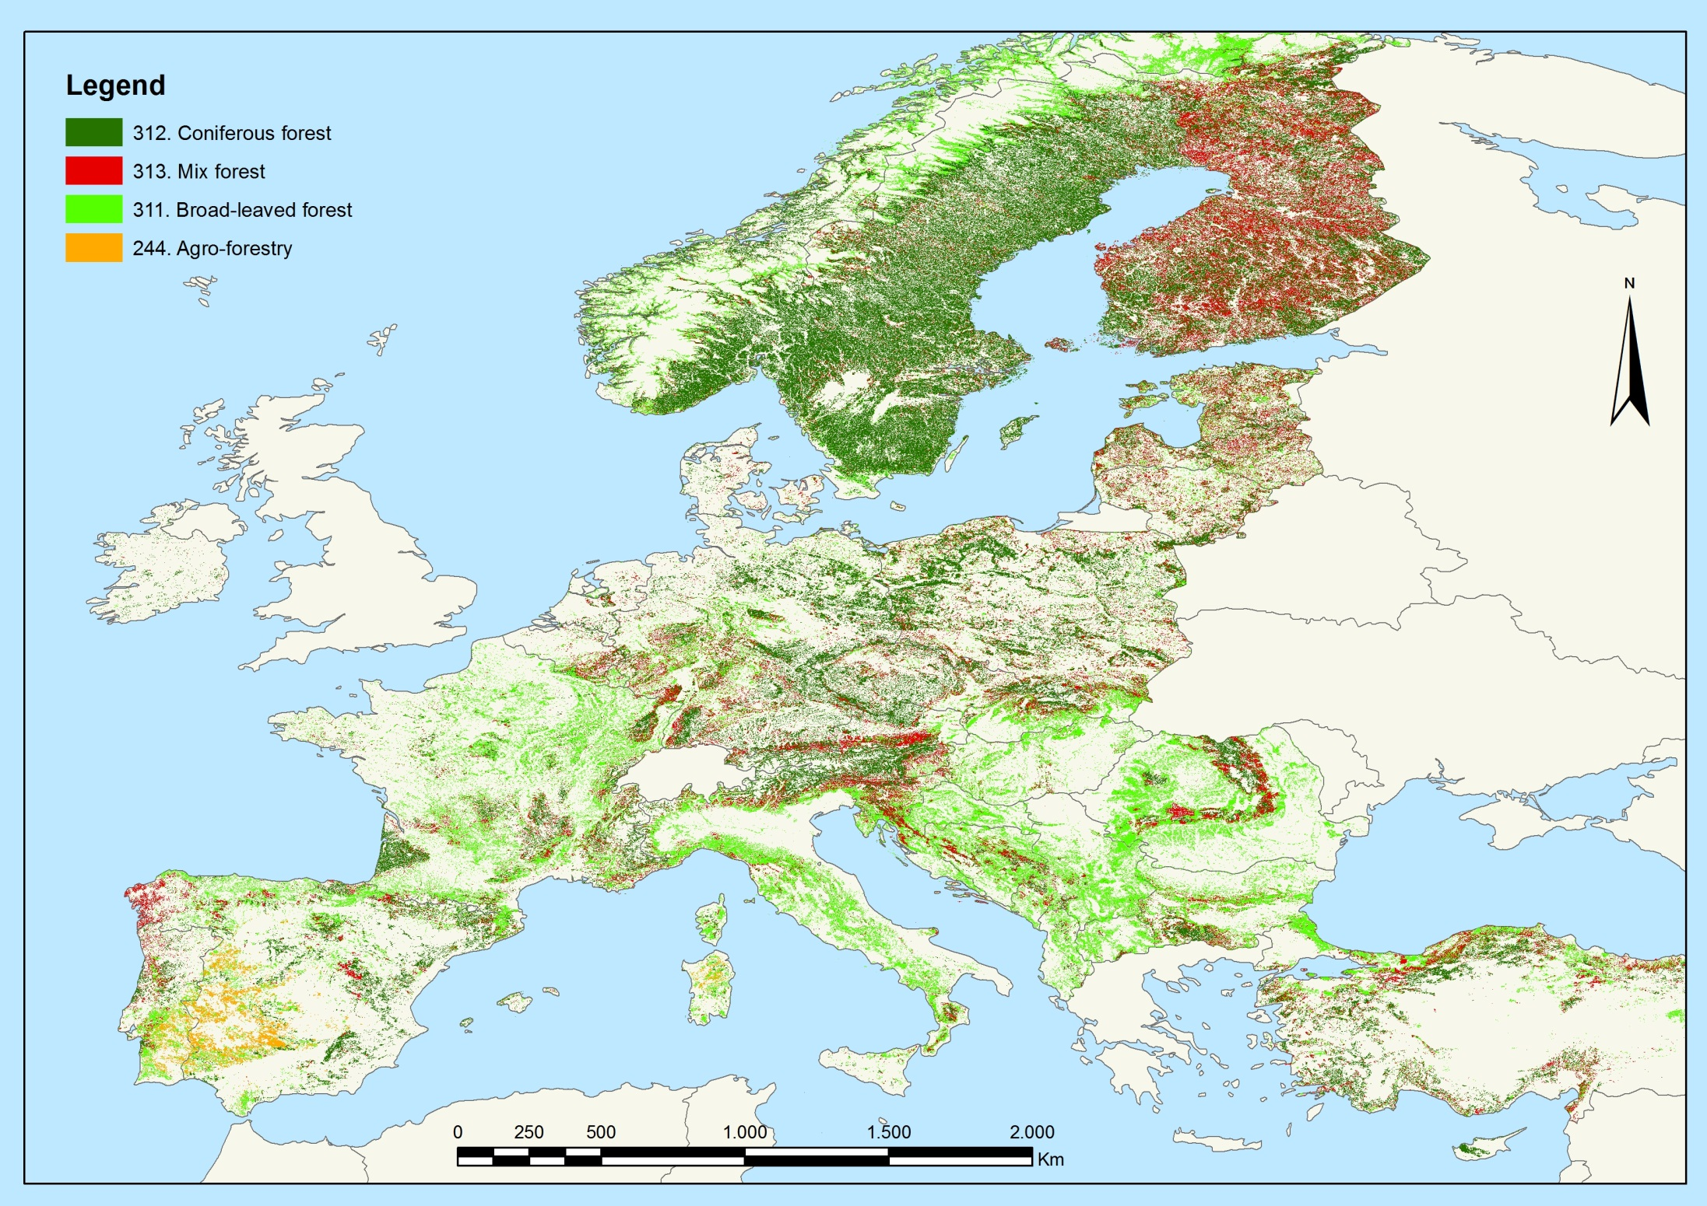
CORINE LAND COVER 2006

Slide 2
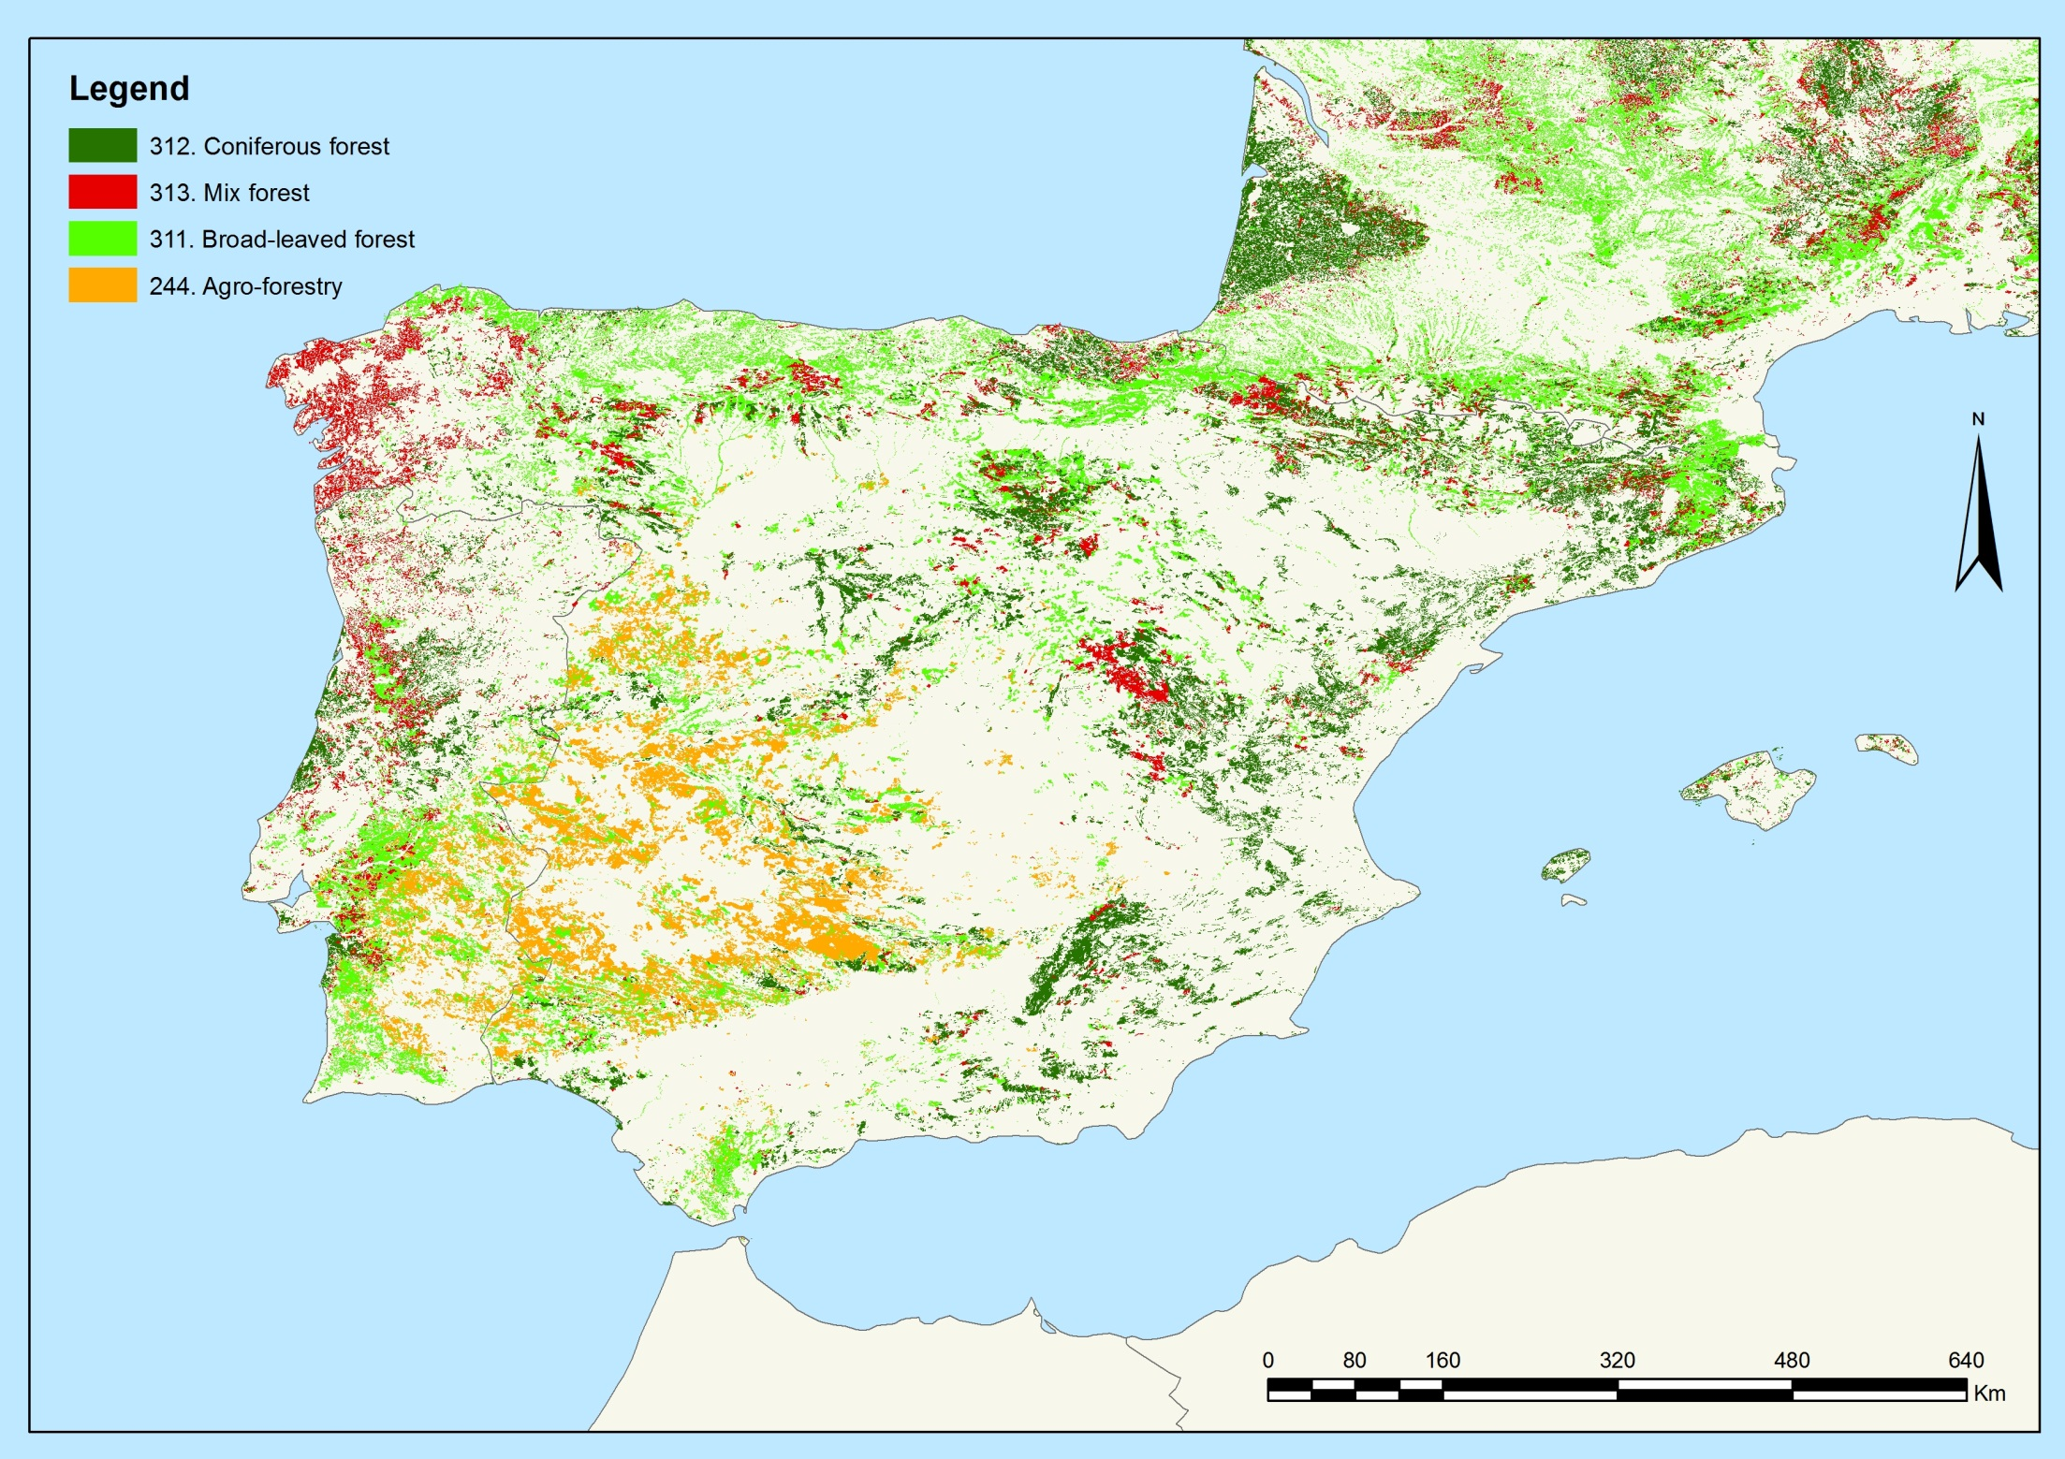
CORINE LAND COVER 2006

